Slide 1
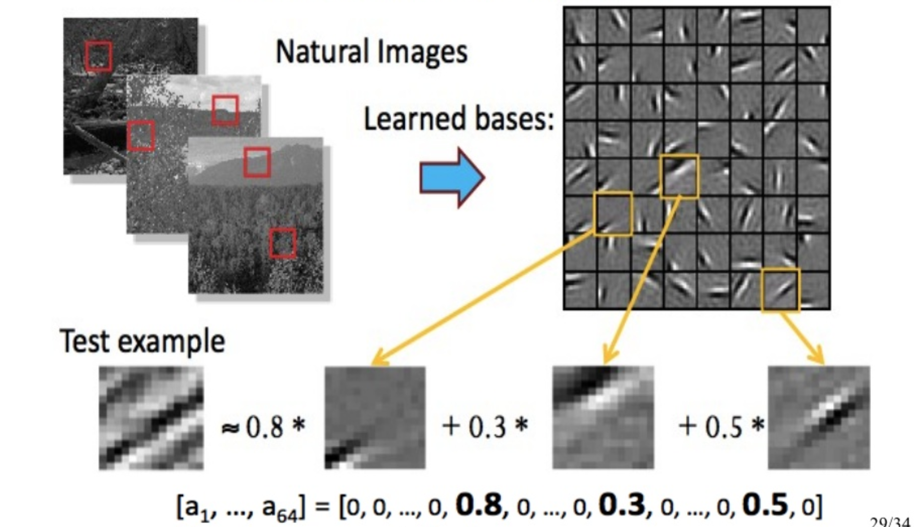
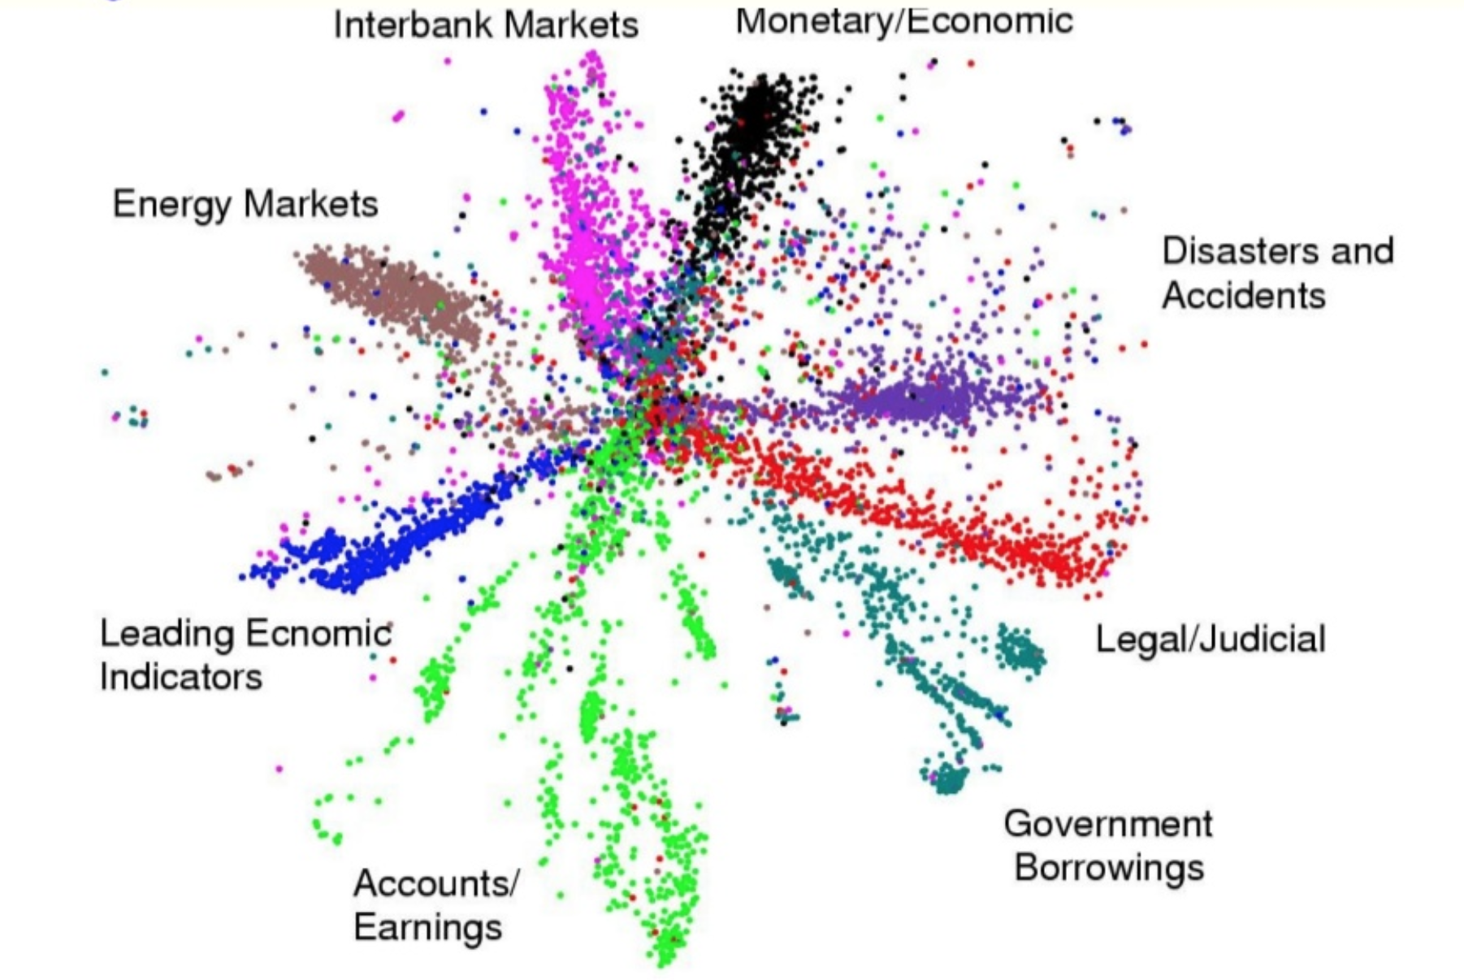
Lecture 35: Deep Generative Models and Autoencoders
Objectives:
Autoencoders
Generative Adversarial Networks
Resources:
Textbook (Sects. 10.3, 10.4)
Autoencoders (Mirowski)
Autoencoder (Stewart)
Autoencoders (Stanford UFDL)
Autoencoders (Altosaar)
Generative Adversarial Networks
Deep Convolutional GANs

Slide 2
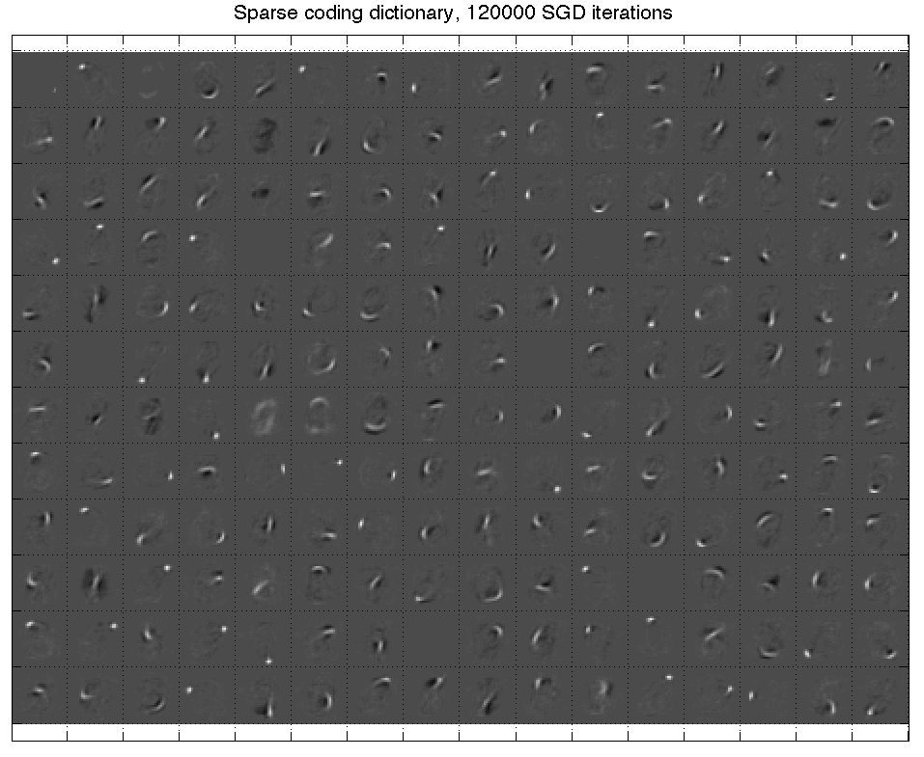
Review of auto-encoders
Sparsity
constraint
Code
Code energy
Input decoding
Code prediction
Decoding energy
Input
Piotr Mirowski, Microsoft Bing London (Dirk Gorissen)
Computational Intelligence Unconference, 26 July 2014

Slide 3
Outline
Deep learning concepts covered
Hierarchical representations
Sparse and/or distributed representations
Supervised vs. unsupervised learning
Auto-encoder
Architecture
Inference and learning
Sparse coding
Sparse auto-encoders
Illustration: handwritten digits
Stacking auto-encoders
Learning representations of digits
Impact on classification
Applications to text
Semantic hashing
Semi-supervised learning
Moving away from auto-encoders
Topics not covered in this talk

Slide 4
Outline
Deep learning concepts covered
Hierarchical representations
Sparse and/or distributed representations
Supervised vs. unsupervised learning
Auto-encoder
Architecture
Inference and learning
Sparse coding
Sparse auto-encoders
Illustration: handwritten digits
Stacking auto-encoders
Learning representations of digits
Impact on classification
Applications to text
Semantic hashing
Semi-supervised learning
Moving away from auto-encoders
Topics not covered in this talk

Slide 5
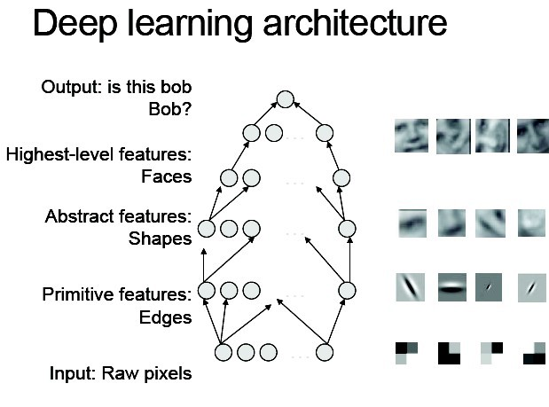
Hierarchical representations
“Deep learning methods aim at learning feature hierarchies with features from higher levels of the hierarchy formed by the composition of lower level features. Automatically learning features at multiple levels of abstraction allows a system to learn complex functions mapping the input to the output directly from data, without depending completely on human-crafted features.” — Yoshua Bengio
[Bengio, “On the expressive power of deep architectures”, Talk at ALT, 2011]
[Bengio, Learning Deep Architectures for AI, 2009]

Slide 6
Sparse and/or distributed representations
Biological motivation: V1 visual cortex
Example on MNIST handwritten digits
An image of size 28x28 pixels can be represented using a small combination of codes from a basis set.
[Ranzato, Poultney, Chopra & LeCun, “Efficient Learning of Sparse Representations with an Energy-Based Model ”, NIPS, 2006; Ranzato, Boureau & LeCun, “Sparse Feature Learning for Deep Belief Networks ”, NIPS, 2007]

Slide 7
Sparse and/or distributed representations
Biological motivation: V1 visual cortex (backup slides)
Example on MNIST handwritten digits
An image of size 28x28 pixels can be represented using a small combination of codes from a basis set.
At the end of this talk, you should know how to learn that basis set and how to infer the codes, in a 2-layer auto-encoder architecture.
Matlab/Octave code and the MNIST dataset will be provided.
[Ranzato, Poultney, Chopra & LeCun, “Efficient Learning of Sparse Representations with an Energy-Based Model ”, NIPS, 2006; Ranzato, Boureau & LeCun, “Sparse Feature Learning for Deep Belief Networks ”, NIPS, 2007]

Slide 8
Supervised learning
Target
Error
Prediction
Input

Slide 9
Supervised learning
Target
Error
Prediction
Input

Slide 10
Why not exploit unlabeled data?

Slide 11
Unsupervised learning
No target…
No error…
Prediction
Input

Slide 12
Unsupervised learning
Code “latent/hidden” representation
Error(s)
Prediction(s)
Input

Slide 13
Unsupervised learning
We want the codes to represent the inputs in the dataset.
Code
Error(s)
The code should be a compact representation of the inputs: low-dimensional and/or sparse.
Prediction(s)
Input

Slide 14
Examples of unsupervised learning
Linear decomposition of the inputs:
Principal Component Analysis and Singular Value Decomposition
Independent Component Analysis [Bell & Sejnowski, 1995]
Sparse coding [Olshausen & Field, 1997]
…
Fitting a distribution to the inputs:
Mixtures of Gaussians
Use of Expectation-Maximization algorithm [Dempster et al, 1977]
…
For text or discrete data:
Latent Semantic Indexing [Deerwester et al, 1990]
Probabilistic Latent Semantic Indexing [Hofmann et al, 1999]
Latent Dirichlet Allocation [Blei et al, 2003]
Semantic Hashing
…

Slide 15
Objective of this tutorial
Study a fundamental building block for deep learning, the auto-encoder

Slide 16
Outline
Deep learning concepts covered
Hierarchical representations
Sparse and/or distributed representations
Supervised vs. unsupervised learning
Auto-encoder
Architecture
Inference and learning
Sparse coding
Sparse auto-encoders
Illustration: handwritten digits
Stacking auto-encoders
Learning representations of digits
Impact on classification
Applications to text
Semantic hashing
Semi-supervised learning
Moving away from auto-encoders
Topics not covered in this talk

Slide 17
Auto-encoder
Target = input
Target = input
Code
Code
Input
Input
“Bottleneck” code i.e., low-dimensional, typically dense, distributed representation
“Overcomplete” code i.e., high-dimensional, always sparse, distributed representation

Slide 18
Auto-encoder
Code
Encoding “energy”
Input decoding
Code prediction
Decoding “energy”
Input

Slide 19
Auto-encoder
Code
Encoding energy
Input decoding
Code prediction
Decoding energy
Input

Slide 20
Auto-encoder loss function
For one sample t
Encoding energy
Decoding energy
coefficient of
the encoder error
For all T samples
Encoding energy
Decoding energy
How do we get the codes Z?
We note W={C, b_{C}, D, b_{D}}

Slide 21
Learning and inference in auto-encoders
Infer the codes Z given the current model parameters W
Learn the parameters (weights) W of the encoder and decoder given the current codes Z
Relationship to Expectation-Maximization in graphical models (backup slides)

Slide 22
Learning and inference: stochastic gradient descent
Iterated gradient descent (?) on the code Z(t) given the current model parameters W
Take a gradient descent step on the parameters (weights) W of the encoder and decoder given the current codes Z
Relationship to Generalized EM in graphical models (backup slides)

Slide 23
Auto-encoder
Code
Encoding energy
Input decoding
Code prediction
Decoding energy
Input

Slide 24
Auto-encoder: fprop
Code
function [x_hat, a_hat] = … Module_Decode_FProp(model, z)
% Apply the logistic to the code
a_hat = 1 ./ (1 + exp(-z));
% Linear decoding
x_hat = model.D * a_hat + model.bias_D;
function e = Loss_Gaussian(z, z_hat)
zDiff = z_hat - z;
e = 0.5 * sum(zDiff.^2);
function z_hat = … Module_Encode_FProp(model, x, params)
% Compute the linear encoding activation
z_hat = model.C * x + model.bias_C;
function e = Loss_Gaussian(x, x_hat)
xDiff = x_hat - x;
e = 0.5 * sum(xDiff.^2);
Input

Slide 25
Auto-encoder backprop w.r.t. codes
Code
Encoding energy
Code prediction
Input
[Ranzato, Boureau & LeCun, “Sparse Feature Learning for Deep Belief Networks ”, NIPS, 2007]

Slide 26
Auto-encoder: backprop w.r.t. codes
Code
function dL_dz = ... Module_Decode_BackProp_Codes(model, dL_dx, a_hat)
% Gradient of the loss w.r.t. activations
dL_da = model.D' * dL_dx;
% Gradient of the loss w.r.t. latent codes % a_hat = 1 ./ (1 + exp(-z_hat))
dL_dz = dL_da .* a_hat .* (1 - a_hat);
% Add the gradient w.r.t.
% the encoder's outputs
dL_dz = z_star - z_hat;
% Gradient of the loss w.r.t. % the decoder prediction
dL_dx_star = x_star - x;
Input
[Ranzato, Boureau & LeCun, “Sparse Feature Learning for Deep Belief Networks ”, NIPS, 2007]

Slide 27
Code inference in the auto-encoder
function [z_star, z_hat, loss_star, loss_hat] = Layer_Infer(model, x, params)
% Encode the current input and initialize the latent code
z_hat = Module_Encode_FProp(model, x, params);
% Decode the current latent code
[x_hat, a_hat] = Module_Decode_FProp(model, z_hat);
% Compute the current loss term due to decoding (encoding loss is 0)
loss_hat = Loss_Gaussian(x, x_hat);
% Relaxation on the latent code: loop until convergence
x_star = x_hat; a_star = a_hat; z_star = z_hat; loss_star = loss_hat;
while (true)
% Gradient of the loss function w.r.t. decoder prediction
dL_dx_star = x_star - x;
% Back-propagate the gradient of the loss onto the codes
dL_dz = Module_Decode_BackProp_Codes(model, dL_dx_star, a_star, params);
% Add the gradient w.r.t. the encoder's outputs
dL_dz = dL_dz + params.alpha_c * (z_star - z_hat);
% Perform one step of gradient descent on the codes
z_star = z_star - params.eta_z * dL_dz;
% Decode the current latent code
[x_star, a_star] = Module_Decode_FProp(model, z_star);
% Compute the current loss and convergence criteria
loss_star = Loss_Gaussian(x, x_star) + ...
params.alpha_c * Loss_Gaussian(z_star, z_hat);
% Stopping criteria [...]
end
Code
Encoding energy
Code prediction
Input
[Ranzato, Boureau & LeCun, “Sparse Feature Learning for Deep Belief Networks ”, NIPS, 2007]

Slide 28
Auto-encoder backprop w.r.t. codes
Code
Encoding energy
Code prediction
Input
[Ranzato, Boureau & LeCun, “Sparse Feature Learning for Deep Belief Networks ”, NIPS, 2007]

Slide 29
Auto-encoder: backprop w.r.t. weights
Code
% Gradient of the loss w.r.t. codes
dL_dz = z_hat - z_star;
function model = ...
Module_Decode_BackProp_Weights(model, ... dL_dx_star, a_star, params)
% Jacobian of the loss w.r.t. decoder matrix
model.dL_dD = dL_dx_star * a_star';
% Gradient of the loss w.r.t. decoder bias
model.dL_dbias_D = dL_dx_star;
function model = ...
Module_Encode_BackProp_Weights(model, ... dL_dz, x, params)
% Jacobian of the loss w.r.t. encoder matrix
model.dL_dC = dL_dz * x';
% Gradient of the loss w.r.t. encoding bias
model.dL_dbias_C = dL_dz;
% Gradient of the loss w.r.t. reconstruction
dL_dx_star = x_star - x;
Input
[Ranzato, Boureau & LeCun, “Sparse Feature Learning for Deep Belief Networks ”, NIPS, 2007]

Slide 30
Usual tricks about classical SGD
Regularization (L1-norm or L2-norm) of the parameters?
Learning rate?
Learning rate decay?
Momentum term on the parameters?
Choice of the learning hyperparameters
Cross-validation?

Slide 31
Sparse coding
Sparsity constraint
Overcomplete code
Input decoding
Decoding error
Input
[Olshausen & Field, “Sparse coding with an overcomplete basis set: a strategy employed by V1? ”, Vision Research, 1997]

Slide 32
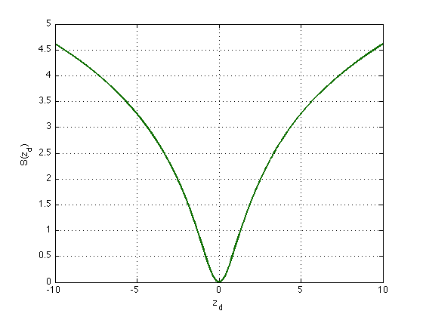
Sparse coding
Sparsity constraint
Overcomplete code
Input decoding
Decoding error
Input
[Olshausen & Field, “Sparse coding with an overcomplete basis set: a strategy employed by V1? ”, Vision Research, 1997]

Slide 33
Limitations of sparse coding
At runtime, assuming a trained model W, inferring the code Z given an input sample X is expensive
Need a tweak on the model weights W: normalize the columns of W to unit length after each learning step
Otherwise:
code pulled to 0 by sparsity constraint
weights go to infinity to compensate

Slide 34
Sparse auto-encoder
Sparsity constraint
Code
Code error
Input decoding
Code prediction
Decoding error
Input
[Ranzato, Poultney, Chopra & LeCun, “Efficient Learning of Sparse Representations with an Energy-Based Model ”, NIPS, 2006; Ranzato, Boureau & LeCun, “Sparse Feature Learning for Deep Belief Networks ”, NIPS, 2007]

Slide 35
Symmetric sparse auto-encoder
Sparsity constraint
Code
Encoder matrix W is symmetric to decoder matrix W^{T}
Code error
Input decoding
Code prediction
Decoding error
Input
[Ranzato, Poultney, Chopra & LeCun, “Efficient Learning of Sparse Representations with an Energy-Based Model ”, NIPS, 2006; Ranzato, Boureau & LeCun, “Sparse Feature Learning for Deep Belief Networks ”, NIPS, 2007]

Slide 36
Predictive Sparse Decomposition
Code
Once the encoder g is properly trained, the code Z can be directly predicted from input X
Code prediction
Input

Slide 37
Outline
Deep learning concepts covered
Hierarchical representations
Sparse and/or distributed representations
Supervised vs. unsupervised learning
Auto-encoder
Architecture
Inference and learning
Sparse coding
Sparse auto-encoders
Illustration: handwritten digits
Stacking auto-encoders
Learning representations of digits
Impact on classification
Applications to text
Semantic hashing
Semi-supervised learning
Moving away from auto-encoders
Topics not covered in this talk

Slide 38
Stacking auto-encoders
Code
Sparsity
constraint
Code energy
Input decoding
Code prediction
Decoding energy
[Ranzato, Boureau & LeCun, “Sparse Feature Learning for Deep Belief Networks ”, NIPS, 2007]
Input
Sparsity
constraint
Code
Code energy
Input decoding
Code prediction
Decoding energy
Input

Slide 39


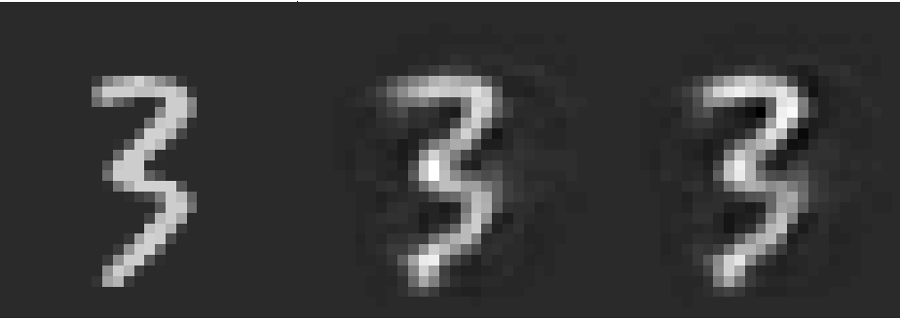
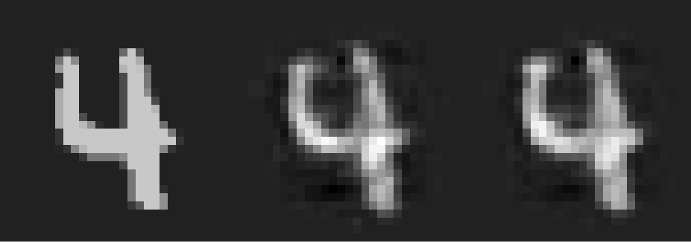
MNIST handwritten digits
Database of 70k handwritten digits
Training set: 60k
Test set: 10k
28 x 28 pixels
Best performing classifiers:
Linear classifier: 12% error
Gaussian SVM 1.4% error
ConvNets <1% error
[http://yann.lecun.com/exdb/mnist/]

Slide 40
Stacked auto-encoders
Code
Sparsity
constraint
Layer 2: Matrix W₂ of size 10 x 192 10 sparse bases of 192 units
Code energy
Input decoding
Code prediction
Decoding energy
Layer 1: Matrix W₁ of size 192 x 784 192 sparse bases of 28 x 28 pixels
[Ranzato, Boureau & LeCun, “Sparse Feature Learning for Deep Belief Networks ”, NIPS, 2007]
Input
Sparsity
constraint
Code
Code energy
Input decoding
Code prediction
Decoding energy
Input

Slide 41
Our results: bases learned on layer 1

Slide 42
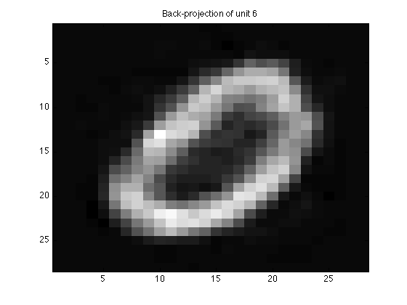
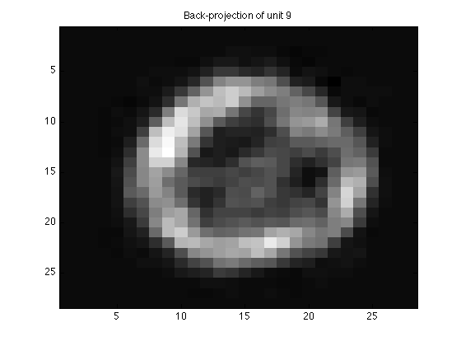
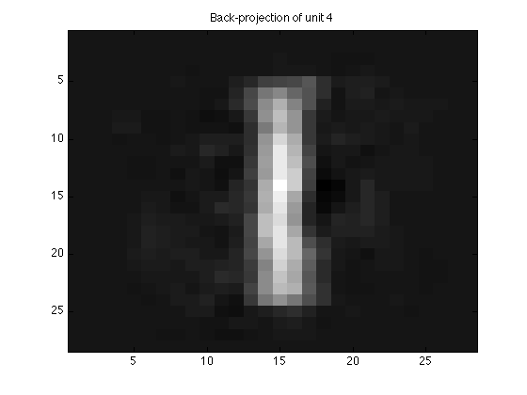
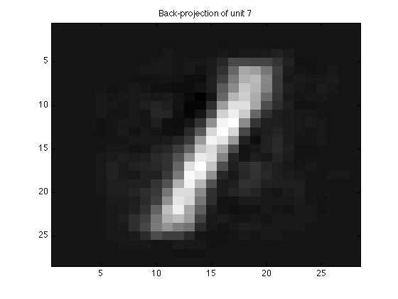
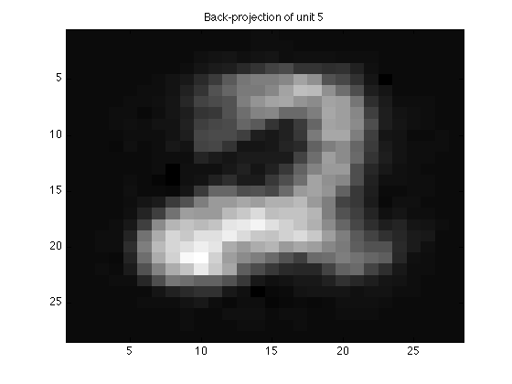
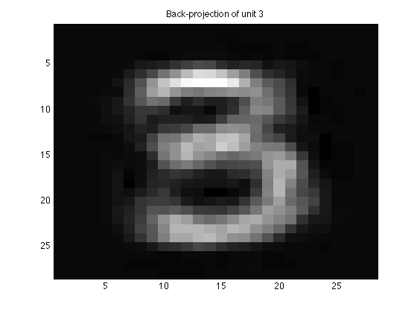
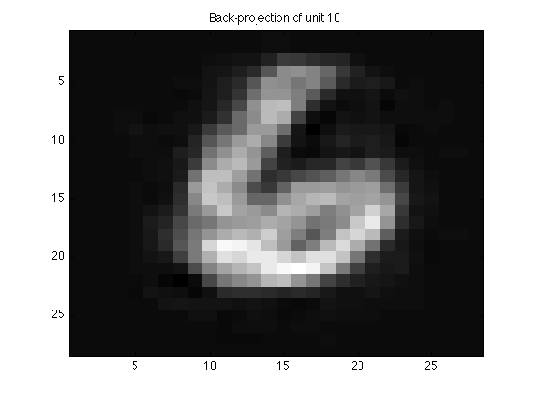
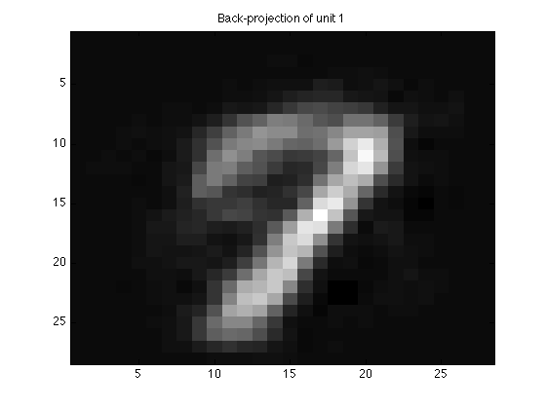
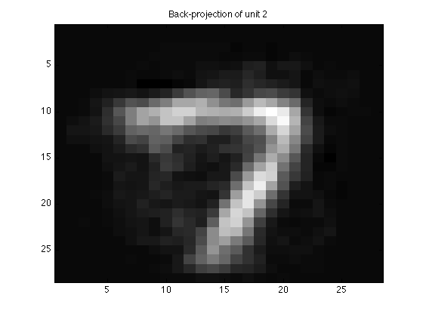
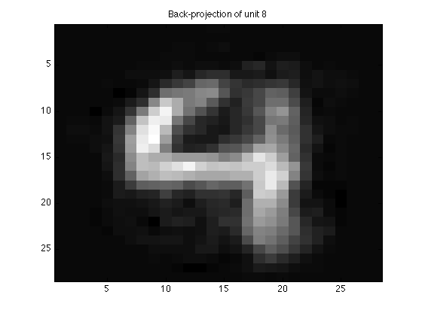
Our results: back-projecting layer 2

Slide 43
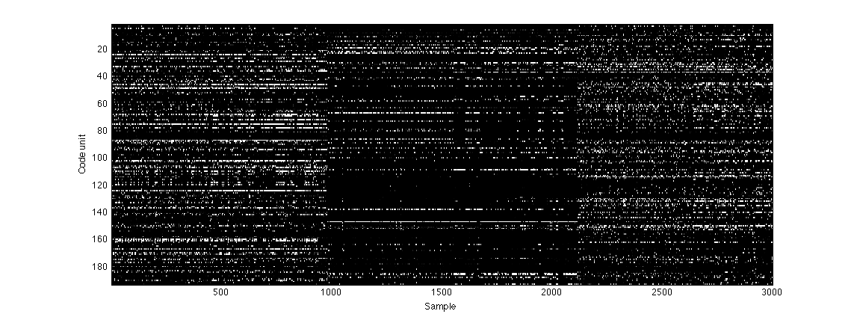
Sparse representations
Layer 1
Layer 2

Slide 44
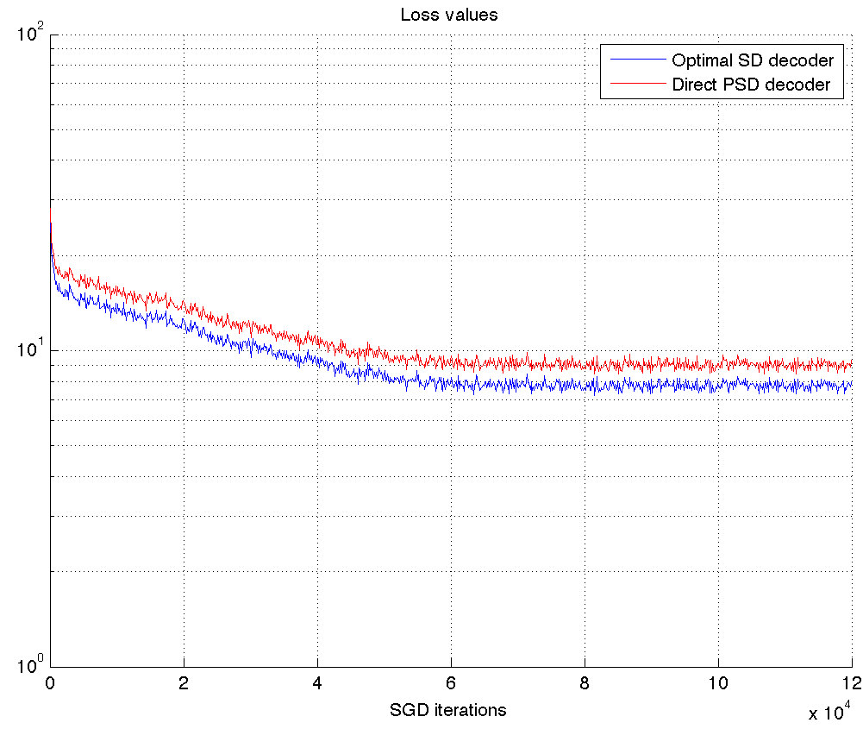
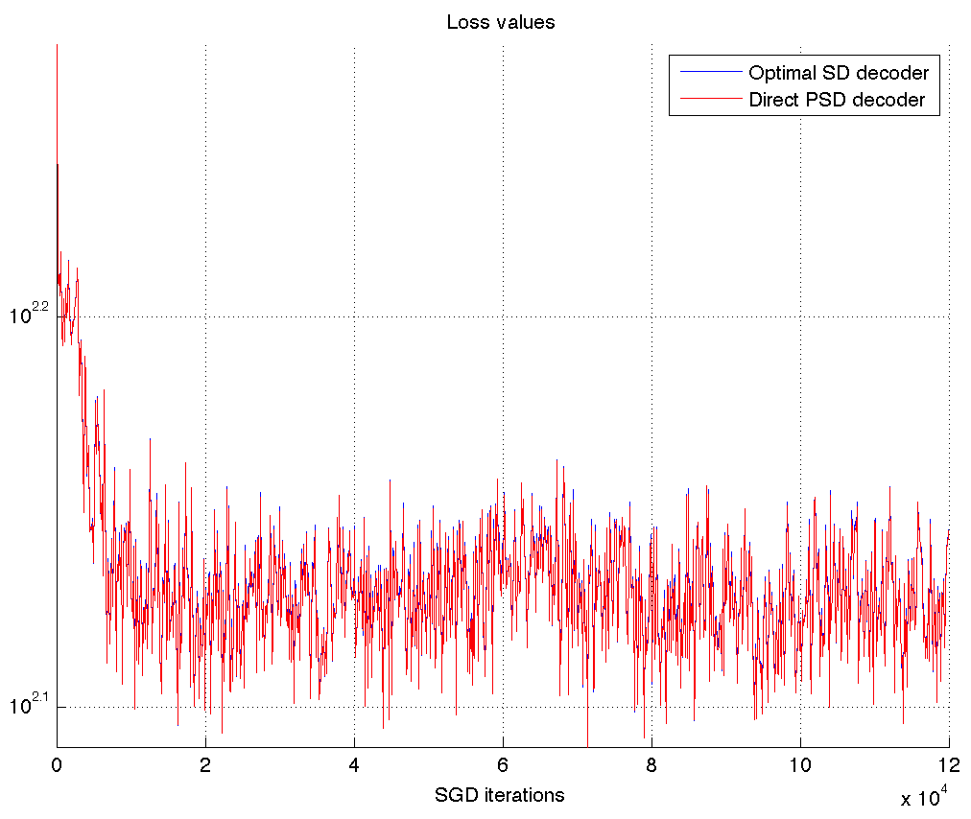
Training “converges” in one pass over data
Layer 1
Layer 2

Slide 45
Outline
Deep learning concepts covered
Hierarchical representations
Sparse and/or distributed representations
Supervised vs. unsupervised learning
Auto-encoder
Architecture
Inference and learning
Sparse coding
Sparse auto-encoders
Illustration: handwritten digits
Stacking auto-encoders
Learning representations of digits
Impact on classification
Applications to text
Semantic hashing
Semi-supervised learning
Moving away from auto-encoders
Topics not covered in this talk

Slide 46
Semantic Hashing
2000
500
250
125
2
125
250
500
2000
[Hinton & Salakhutdinov, “Reducing the dimensionality of data with neural networks, Science, 2006; Salakhutdinov & Hinton, “Semantic Hashing”, Int J Approx Reason, 2007]

Slide 47
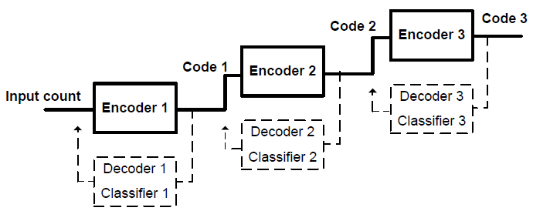
Semi-supervised learning of auto-encoders
Add classifier module to the codes
When a input X(t) has a label Y(t), back-propagate the prediction error on Y(t) to the code Z(t)
Stack the encoders
Train layer-wise
y(t)
y(t+1)
document
classifier f3
z⁽³⁾(t)
z⁽³⁾(t+1)
y(t)
y(t+1)
auto-encoder g3,h3
document
classifier f2
z⁽²⁾(t)
z⁽²⁾(t+1)
y(t)
y(t+1)
auto-encoder g2,h2
document
classifier f1
z⁽¹⁾(t)
z⁽¹⁾(t+1)
Random
walk
auto-encoder g1,h1
word histograms
x(t)
x(t+1)
[Ranzato & Szummer, “Semi-supervised learning of compact document representations with deep networks”, ICML, 2008; Mirowski, Ranzato & LeCun, “Dynamic auto-encoders for semantic indexing”, NIPS Deep Learning Workshop, 2010]

Slide 48
Semi-supervised learning of auto-encoders
Performance on document retrieval task: Reuters-21k dataset (9.6k training, 4k test), vocabulary 2k words, 10-class classification
Comparison with:
unsupervised techniques (DBN: Semantic Hashing, LSA) + SVM
traditional technique: word TF-IDF + SVM
[Ranzato & Szummer, “Semi-supervised learning of compact document representations with deep networks”, ICML, 2008; Mirowski, Ranzato & LeCun, “Dynamic auto-encoders for semantic indexing”, NIPS Deep Learning Workshop, 2010]

Slide 49
Beyond auto-encoders for web search (MSR)
Compute Cosine similarity
between semantic vectors
cos(s,t1)
cos(s,t2)
Semantic vector
d=300
d=300
d=300
W₄
d=500
d=500
d=500
W₃
Letter-tri-gram embedding matrix
d=500
d=500
d=500
W₂
Letter-tri-gram coeff.
matrix (fixed)
dim = 50K
dim = 50K
dim = 50K
W₁
Bag-of-words vector
dim = 5M
dim = 5M
dim = 5M
Input word/phrase
s: “racing car”
t1: “formula one”
t2: “ford model t”
[Huang, He, Gao, Deng et al, “Learning Deep Structured Semantic Models for Web Search using Clickthrough Data”, CIKM, 2013]

Slide 50
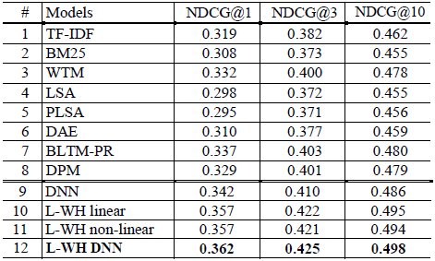
Beyond auto-encoders for web search (MSR)
Results on a web ranking task (16k queries) Normalized discounted cumulative gains
Semantic hashing [Salakhutdinov & Hinton, 2007]
Deep Structured Semantic Model [Huang, He, Gao et al, 2013]
[Huang, He, Gao, Deng et al, “Learning Deep Structured Semantic Models for Web Search using Clickthrough Data”, CIKM, 2013]

Slide 51
Outline
Deep learning concepts covered
Hierarchical representations
Sparse and/or distributed representations
Supervised vs. unsupervised learning
Auto-encoder
Architecture
Inference and learning
Sparse coding
Sparse auto-encoders
Illustration: handwritten digits
Stacking auto-encoders
Learning representations of digits
Impact on classification
Applications to text
Semantic hashing
Semi-supervised learning
Moving away from auto-encoders
Topics not covered in this talk

Slide 52
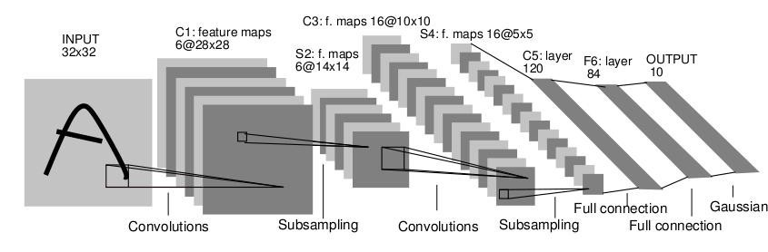
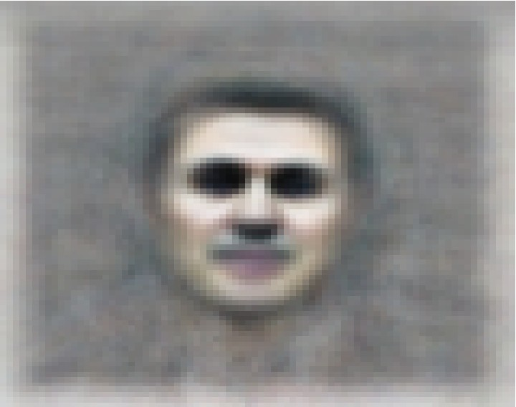
Topics not covered in this talk
Other variations of auto-encoders
Restricted Boltzmann Machines (work in Geoff Hinton’s lab)
Denoising Auto-Encoders (work in Yoshua Bengio’s lab)
Invariance to shifts in input and feature space
Convolutional kernels
Sliding windows over input
Max-pooling over codes
[LeCun, Bottou, Bengio & Haffner, “Gradient-based learning applied to document recognition”, Proceedings of IEEE,1998;
Le, Ranzato et al. "Building high-level features using large-scale unsupervised learning" ICML 2012; Sermanet et al, “OverFeat: Integrated Recognition, Localization and Detection using Convolutional Networks”, ICLR 2014]

Slide 53
Thank you!
Tutorial code: https://github.com/piotrmirowski http://piotrmirowski.wordpress.com
Contact: piotr.mirowski@computer.org
Acknowledgements: Marc’Aurelio Ranzato (FB) Yann LeCun (FB/NYU)

Slide 54
Auto-encoders and Expectation-Maximization
Energy of inputs and codes
Input data likelihood
Do not marginalize over: take maximum likelihood latent code instead
Maximum A Posteriori: take minimal energy code Z
Enforce sparsity on Z to constrain Z and avoid computing partition function

Slide 55
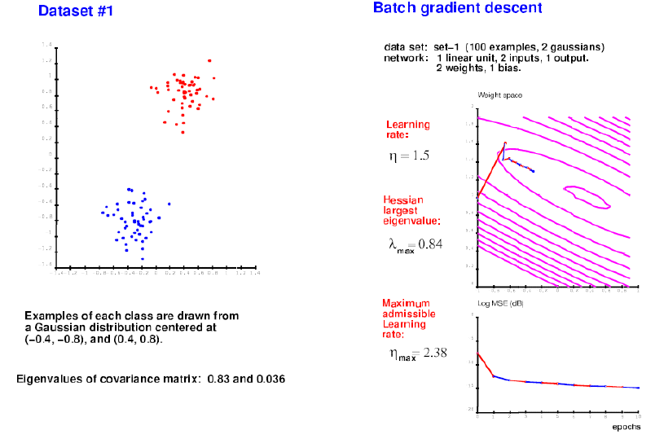
Stochastic gradient descent
[LeCun et al, "Efficient BackProp", Neural Networks: Tricks of the Trade, 1998; Bottou, "Stochastic Learning", Slides from a talk in Tubingen, 2003]

Slide 56
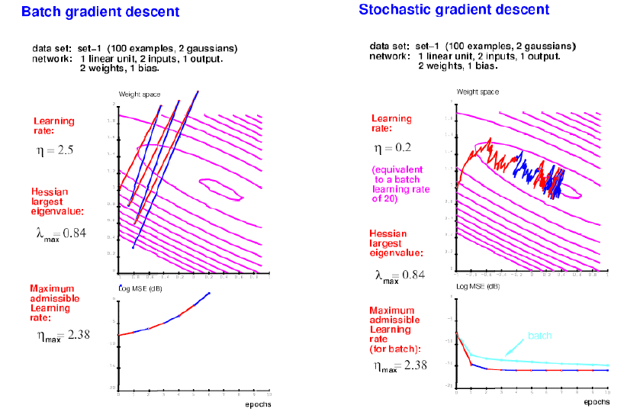
Stochastic gradient descent
[LeCun et al, "Efficient BackProp", Neural Networks: Tricks of the Trade, 1998; Bottou, "Stochastic Learning", Slides from a talk in Tubingen, 2003]

Slide 57
Dimensionality reduction and invariant mapping
Similarly labelled samples
Dissimilar codes
[Hadsell, Chopra & LeCun, “Dimensionality Reduction by Learning an Invariant Mapping”, CVPR, 2006]

Slide 58
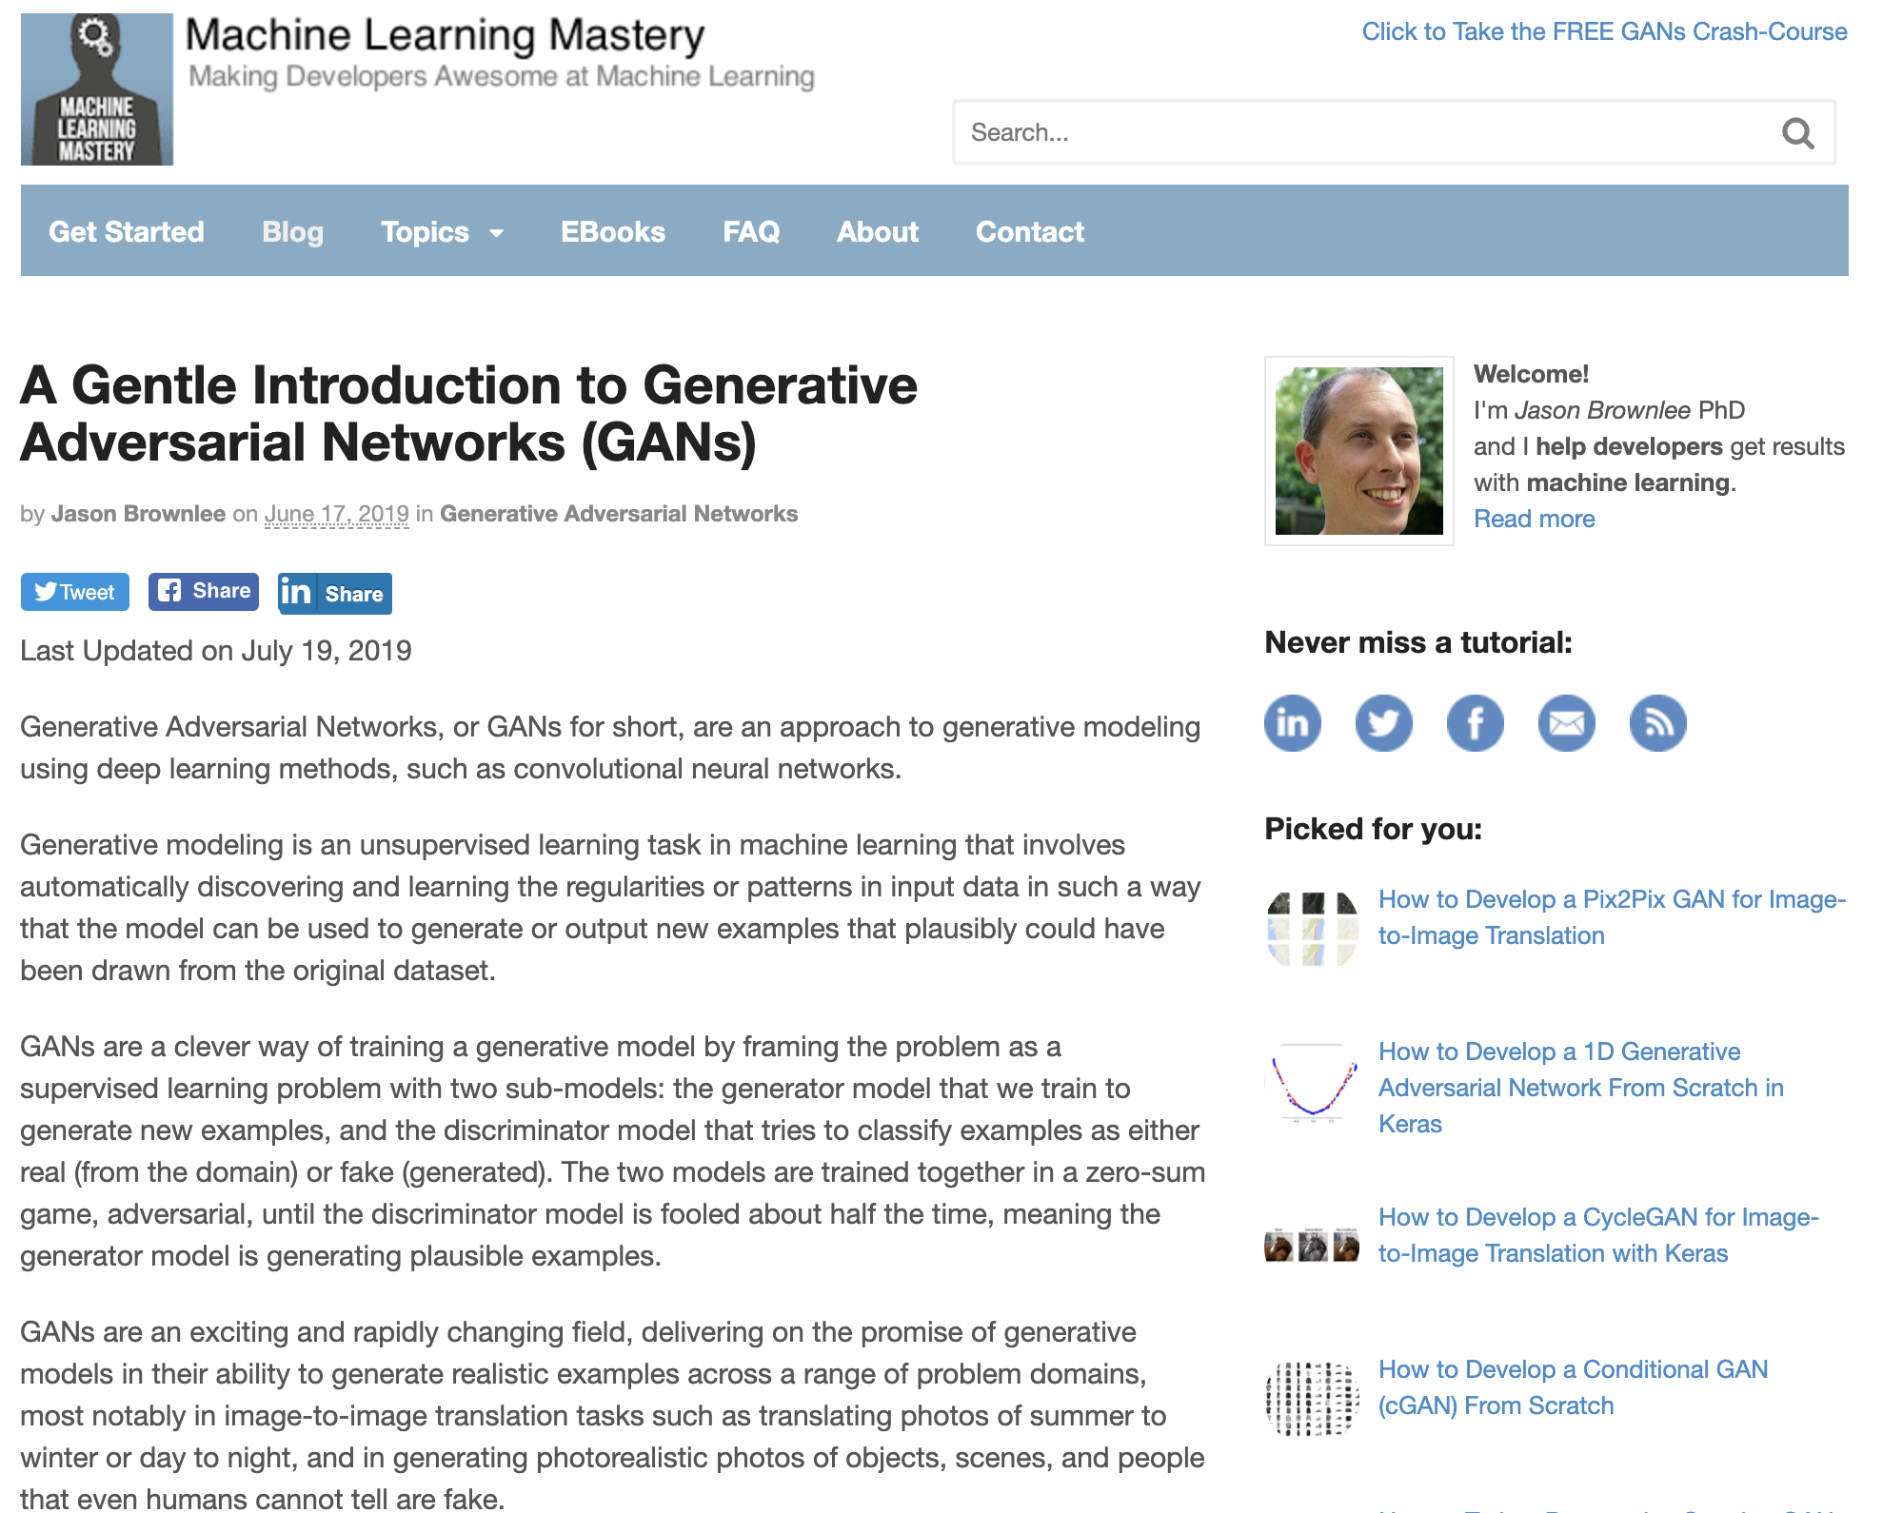
Generative Adversarial Networks
Notes:
http://www.iro.umontreal.ca/~bengioy/papers/ftml.pdf

